Slide 1
Unit 1
Advanced cellular mobile communication systems
WEEK 1 : Overview of the legacy 3GPP cellular systems, WiMAX systems: Introduction
WEEK 2 : WiMAX systems: Architecture, Frame structure, Applications
WEEK 3 : LTE systems: Introduction, Architecture, Frame structure and applications
These slides contains copyrighted materials from - Andrea Molisch, “Wireless Communication”, Cambridge University Press, 2nd edition, 2013.
Text books, references:
Andrea Molisch, “Wireless Communication”, Cambridge University Press, 2nd edition, 2013.

Slide 2
WEEK 1 LECTURES
Overview of the legacy 3GPP cellular systems, WiMAX systems: Introduction

Slide 3
Evolution of Mobile Radio Communications
Major Mobile Radio Systems
1934 - Police Radio uses conventional AM mobile communication system.
1935 - Edwin Armstrong demonstrate FM
1946 - First public mobile telephone service - push-to-talk
1960 - Improved Mobile Telephone Service, IMTS - full duplex
1960 - Bell Lab introduce the concept of Cellular mobile system
1968 - AT&T propose the concept of Cellular mobile system to FCC.
1976 - Bell Mobile Phone service, poor service due to call blocking
1983 - Advanced Mobile Phone System (AMPS), FDMA, FM
1991 - Global System for Mobile (GSM), TDMA, GMSK
1991 - U.S. Digital Cellular (USDC) IS-54, TDMA, DQPSK
1993 - IS-95, CDMA, QPSK, BPSK

Slide 4
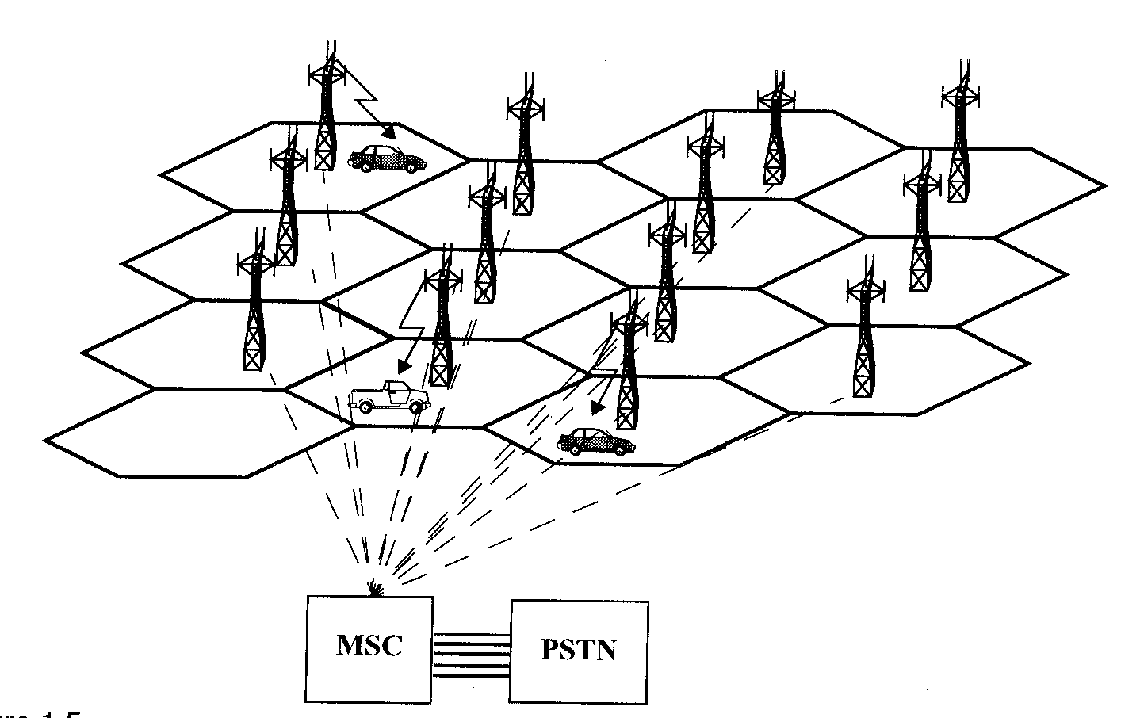
Cellular Telephone Systems
Provide connection to the PSTN for any user location within the radio range of the system.
Characteristic
Large number of users
Large Geographic area
Limited frequency spectrum
Reuse of the radio frequency by the concept of “cell’’.
Basic cellular system: mobile stations, base stations, and mobile switching center.
Source : Wireless Communications: Principles and Practice, Theodore S. Rappaport, pp14.

Slide 5
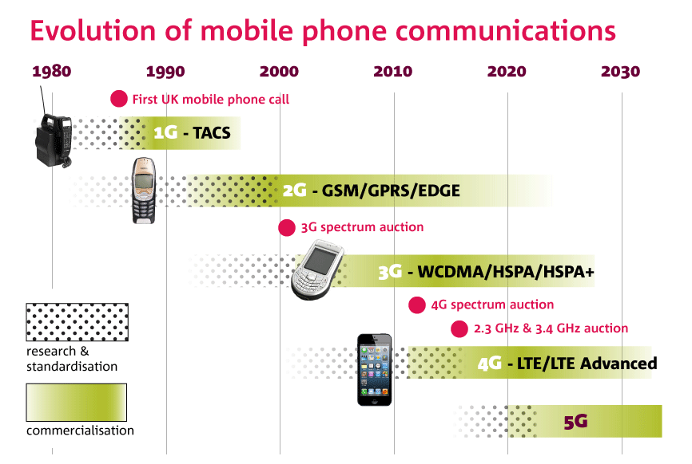
Unit 1 deals with 3GPP – LTE, WiMAX

Slide 6
Technical evolution GSM – EDGE – W-CDMA
The paths to W-CDMA
GSM
EDGE
IMT-2000 family
W-CDMA
DS
GPRS
FDD
TDD High
Low
(aka: TD-SCDMA)
TC
Voice & low-speed data
Voice & medium-speed data
Voice & high-speed data
Circuit Switched
Packet Switched
IP (option)
Paths from other technologies eg. 1G, 2G

Slide 7
Cellular Technology: Evolution
First generation:
➢Based on analog technology, uses a single base station to
communicate with a single portable terminal.(e.g., Advance Mobile
Phone Services - AMPS)
Second generation:
➢Based on digital modulation and advanced call processing
capabilities . (e.g., Global System for Mobile - GSM , IS-95 and
Cordless Telephone - CT2).
Third generation:
➢To provide a single set of standards that can meet a wide range of
wireless applications (Multimedia) and provide universal access
throughout the world.(e.g., WCDMA, CDMA-2000, etc.)
Fourth generation:
➢To enable usage over IP platform – packet switching based (e.g.,
Long Term Evolution-Advanced (LTE-A), Mobile WiMAX)

Slide 8
3GPP Long-Term Evolution
In 2004, rollout of Wideband Code Division Multiple Access (WCDMA) systems was happening, the Third Generation Partnership Project (3GPP) industry consortium started to work on fourth-generation (4G) systems.
It was predicted at that time the data rates and spectral efficiencies of WCDMA would not meet the demand of future applications; therefore, a new system had to be developed.
It was decided to completely change both the air interface and the core network.
The air interface was to move to Orthogonal Frequency Division Multiplexing (OFDM) as modulation, and Orthogonal Frequency Division Multiple Access (OFDMA), with (limited) support for Multiple Input Multiple Output system (MIMO) antenna technology.
The core network was to evolve into a pure packet-switched network.
The new standard became known as 3GPP Long-Term Evolution, or simply LTE.

Slide 9
3GPP Long-Term Evolution
The development of LTE originally took place in parallel to the further evolution of WCDMA. Around 2007/2008, LTE started to take the center stage of the 3GPP meetings.
Release 8 of the LTE specifications provides for data rates up to 300 Mbit/s in the downlink (DL). Further improvements, in particular extending the use of MIMO for increasing the spectral efficiency, are foreseen for future releases.
Release 10, also known as LTE-Advanced is intended to provide data rates up to 1 Gbit/s. LTE-Advanced is also submitted to the International Telecommunications Union (ITU) as one of the candidates for International Mobile Telecommunications (IMT)-Advanced cellular systems.
WCDMA and CDMA2000 network operators migrated to LTE.
While there are still two different flavors of LTE (a Frequency Domain Duplexing (FDD) and a Time Domain Duplexing (TDD) mode, the duplexing method is the only essential difference between them.

Slide 10
3GPP Long-Term Evolution
Why there is such eagerness by the cellular industry to move to a new standard when the investments into 3G are huge.
The reasons are manifold
need for improved data rates and spectral efficiency in particular in dense urban environments,
for some operators, the possibility to “leapfrog” from 2G directly to 4G technology
the competition from WiMAX
the possibility of acquiring new spectrum in the name of getting it for a new system.

Slide 11
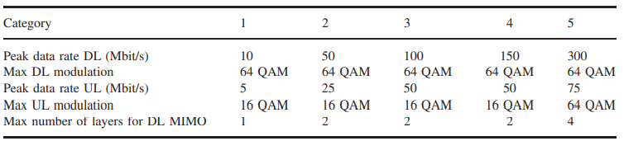
Types of 3GPP Long-Term Evolution and Goals
LTE defines a number of different types of Mobile Stations (MSs) that present a tradeoff between complexity and performance
LTE aims to achieve a peak data rate of 100 Mbit/s in the downlink and 50 Mbit/s in the uplink (UL), respectively, with a 20-MHz spectrum allocation for each of the downlink and uplink.
For latency, the goals distinguish between
Control-plane latency (defined as the time for a handset to transition from various nonactive states to active states), which are between 50 and 100 ms, depending on the state in which the MS originally was. Furthermore, at least 400 active MSs per cell should be supported.
User-plane latency (defined as the time it takes to transmit a small Internet Protocol (IP) packet to the edge node of the Radio Access Network, RAN), which should not exceed 5 ms in a network with a single MS (i.e., no congestion problems.

Slide 12
INTRODUCTION TO WIMAX (IEEE 802.16)
Worldwide Interoperability for Microwave Access (WiMAX) is a wireless communications standard for Metropolitan Area Networks (MANs), e.g., networks covering whole cities or even whole countries.
Originally intended as a standard for Fixed Wireless Access (FWA) using millimeter wave bands (11–60 GHz), it concentrates more and more on providing mobility, and in its latest incarnation has become a competition to third- and fourth-generation cellular systems.

Slide 13
WiMAX has some important advantages
(WIMAX vs 3GPP, CDMA 2000)
WiMAX standard was originally intended for data communications; voice is more of an afterthought that is enabled by Voice over Internet Protocol (VoIP) communications. As the emphasis of future cellular systems will lie on data communications, this is beneficial for WiMAX.
The modulation format and multiple-access format of WiMAX, i.e., MIMO/OFDM/OFDMA, is more suitable for high-data-rate communications.
The standard is much simpler than the 3GPP standard, covering “only” 1,400 pages (compared to the 50,000 pages of 3GPP). As a consequence, the standard can be understood and realized even by relatively small companies, which increases the number of possible suppliers and drives down costs.

Slide 14
WiMAX has some important advantages (WIMAX vs 3GPP, CDMA 2000)
The system architecture is Internet Protocol (IP) based, so that no costly development and deployment of a separate backbone network is required (note, however, that the 3GPP is the evolution of the Global System for Mobile communication (GSM) network; as a consequence, GSM operators migrate to a third-generation system prefer the GSM-style network.
The standard is strongly supported by computer chip manufacturers, which will build WiMAX RXs into most laptops. This leads to an automatic customer base for WiMAX.

